Slide 1


TAG WORLD EXCHANGE
Innovative Cryptocurrency Crowd-lending Platform which Offers Liquidity and Transparency for Investors and Funded Companies

Slide 2
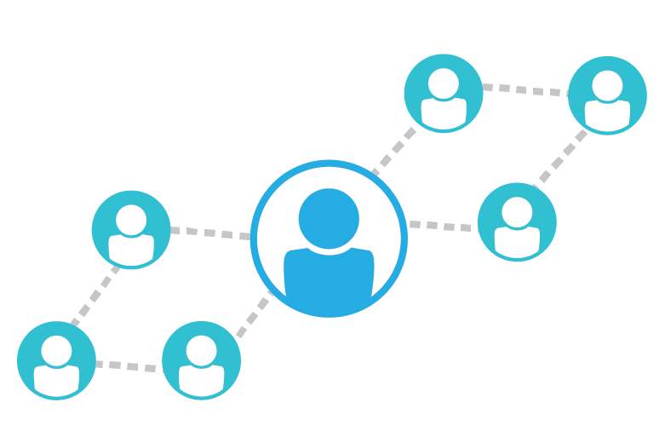
INTRODUCTION
TWEX was born from the frustration of private equity investments and all the pitfalls.
The Tag World Exchange or TWEX, is a worldwide platform that is non-inflationary and based on real-world economies. Specifically, TWEX is a crowd-lending platform that creates liquidity and transparency for investors and funded companies alike.

Slide 3

TWEX PLATFORM

Slide 4
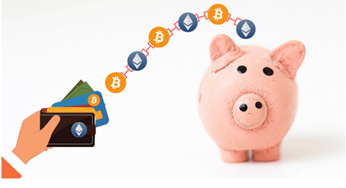
PLATFORM CHARACTERISTICS
Total TWEX Tokens + TPS: 500 million
Price per token: 0.40 €
Accepted FIAT Currencies: USD, EUR, NZD, etc.
Accepted Crypto-Currencies: BTC, ETH, etc.

Slide 5
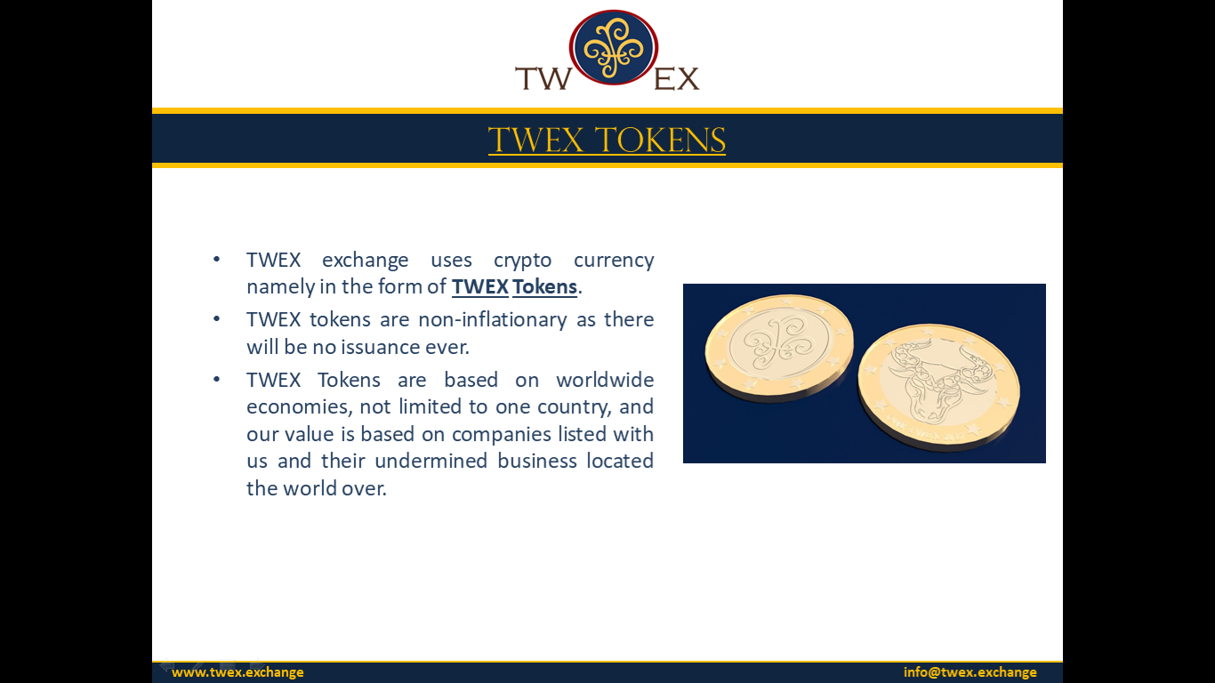
TWEX TOKENS

Slide 6

TWEX TOKENIZED PREFERRED SHARES
Preference Shares issued by TWEX are registered on the Blockchain, holding no equity rights or voting rights. But hold profit participation rights.
Similar to usual Preferred Shares, TWEX TPS holders too are entitled to receive their claims prior to the equity shareholders of the organisation during the winding up of the company.
They act as a proof of membership of their holders in the TWEX Ecosystem and entitle them to benefit from the profit generated by the payment of all Funded Companies.
Each TWEX holder can obtain total access to TWEX's signals, services, information, and analytical products.

Slide 7
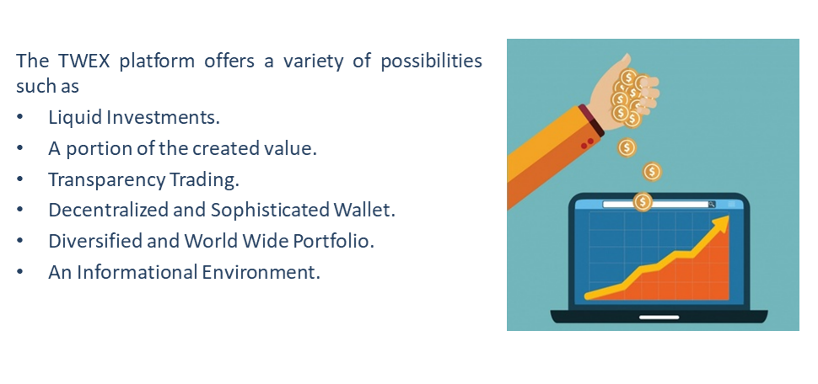
OFFERINGS

Slide 8

BENEFITS
Each TWEX Token is delivered with one TWEX TPS bearing rights to 30 % of all profits generated by the Exchange and 1 % of total sales of all companies listed and benefitting from this funding. Buyers are also remitted ownership on a pro-rated basis to various Smart Contracts for Capital Repayments (SCC) and Profit Participation (SCP) issued by all companies listed on the Exchange and benefitting from this funding. The smart contracts are the proof of their holders’ role as lender to the issuer of the contracts and to their inherent rights to payback of capital and profit following specifics of each smart contract issuer. The TWEX tokens are the proof of their holders’ membership in the TWEX ecosystem. The TWEX TPS – Tokenised Preferred Shares provide their holders a right to receive 1/50000000 per TWEX token held, of all amounts paid by companies that received the initial funding raised for their projects. Each of these companies is obligated to pay to TWEX ltd 1.5 % of their gross sales. 1 % of said gross sales will be deposited in escrow account and distributed accordingly.

Slide 9
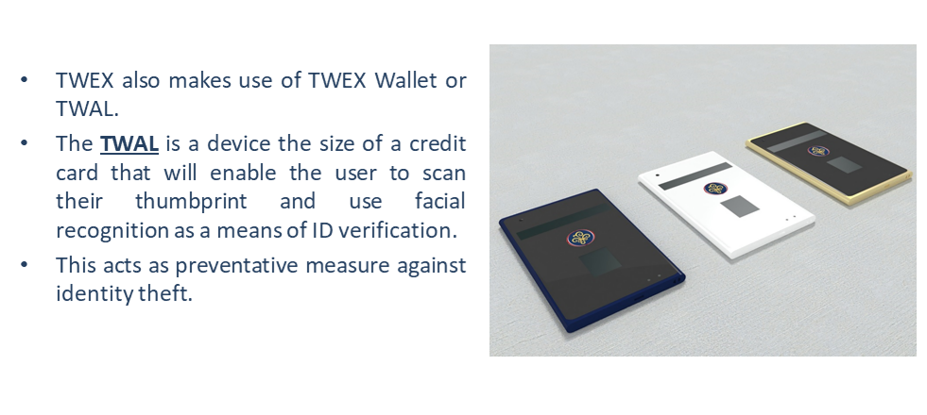
TWEX HARDWARE WALLET (TWAL)

Slide 10

Contact Us
TWEX LTD.
A Tag Banker Company
Address: 71-75 Shelton Street, Covent Garden, London, WC2H 9JQ, United Kingdom
Contact: +44 203 3185473, +44 745 2284216, +33 76 144 2277
Website: www.twex.exchange
EMAIL: info@twex.exchange

